Slide 1
The SoundBytes
Manchester Robot Orchestra
Team members:
Andrei Buruiana, Joyanto Chanda, Theodoros Dimou, Francesco Fumagalli, Antons Petrovs, Joshua Simpson
Supervisors:
Prof. Danielle George & Dr. William McGenn

Slide 2
Project Overview (Andrei)
Project brings together embedded systems and art
Instruments: keyboard, xylophone, panpipes, Telsa coil, stepper motors
The songs are: Eye of The Tiger (Survivor) and Californication (Red Hot Chilli Peppers)
Rising interest, being backed by Siemens and National Instruments
The project can act as a stand-alone core or together with the existing orchestra
The project can be used to promote the university’s courses and at trade fairs
Notes:
The Robot Orchestra brings together embedded systems and art into a single project, a project whose main goal is to have different instruments play together a song, with all the tasks being executed by robots. The selected instruments are a keyboard, a xylophone, panpipes, a Tesla coil and stepper motors. By the end of the project, the instruments will be able to play Eye of The Tiger by Survivor as well as Californication by Red Hot Chili Peppers.
There is a rising interest in this type of applications as the university already has a robot orchestra that was vey well received, having appeared on multiple BBC programmes and being backed by sponsors that include Siemens and National Instruments.
The project can be used to add flexibility to the existing orchestra but it can also act as a stand-alone core. Since the project combines multiple embedded systems with art, it can be used at professional trade fairs to showcase a company’s technology and it can also serve as good aid for the university to promote its courses since it can appeal to a broad audience of different age categories and backgrounds,

Slide 3
Aims & Objectives (Anton)
Aims
Design and assemble 4 new robot instruments
Play 2 different songs with the orchestra
Allow for further music or instrument additions
Objectives
Propose designs for individual instruments
Develop software and construct the hardware
Implement a conductor which will send MIDI files to the instruments
Assemble the orchestra and synchronise the orchestra

Slide 4
Challenges for Semester 1 (Joyanto)
Decision on instruments
Initial research period produced several designs to review
Decision of songs
Facebook poll conducted with large amount of songs
Eye of the Tiger – Survivor
Californication – Red Hot Chilli Peppers
Game of Thrones Theme Song *backup
Synchronising the instruments
Notes:
In order to progress with the project one of the main objectives for the first project block was to make a decision on the instruments to be attempted and what songs would be played
Decision on songs and instruments need to be completed together
This was important – some of the robot design could be simplified to play certain songs
For example, keyboard is capable of playing 61 keys but only needs 19 for the songs we picked

Slide 5
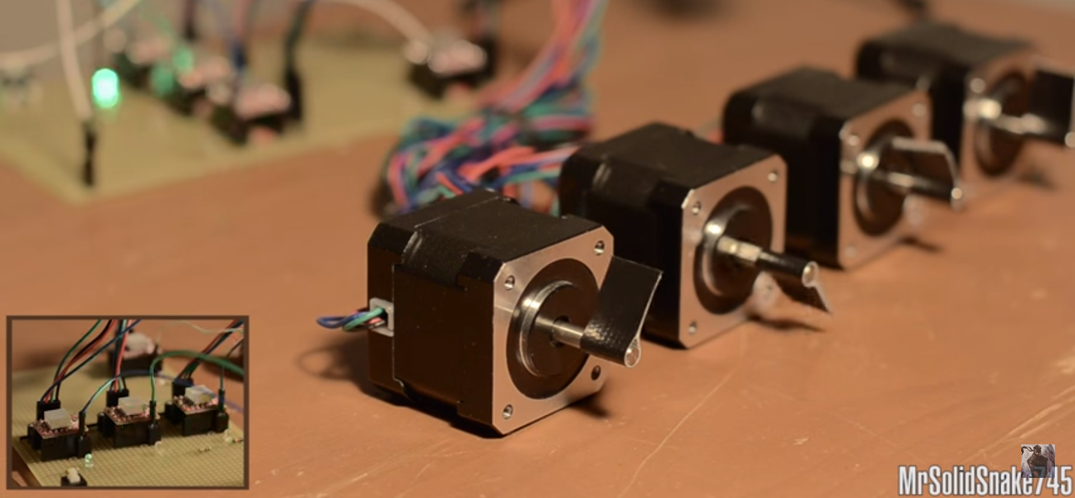
Stepper motor background

Slide 6
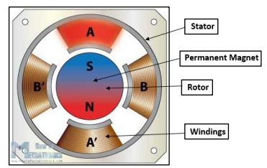
Stepper Motors (Francesco + Andrei)
How do they work?
DC motor that converts digital pulses into steps of a rotation
Varying the pulse frequency modifies the shaft rotation
Permanent magnet acts as a rotor
When a winding is activated, the stator attracts the disc of opposite polarity in the rotor
The rotation can be controlled with a PWM signal
If the PWM frequency is in the audible range, the motor can produce different musical notes
Notes:
How a stepper motor works
A stepper motor is a DC motor that converts digital pulses into equal steps of a rotation. By varying the frequency of the pulses, the rotation of the shaft can be modified and a high frequency of pulses translates to a continuous movement of the shaft.
The permanent magnet acts as a rotor and is surrounded by the windings of the stator. The rotor has two discs placed back to back, one acting as the magnetic north pole and the other as the magnetic south pole. When a winding is activated, the stator attracts the disc of opposite polarity of the rotor, generating the rotational movement. The rotation of the motor can be controlled with a PWM signal of different frequencies and if the frequency is the audible range, the motor is able to produce different musical notes.

Slide 7
Arduino Timers (Andrei)
The stepper motor was initially controlled using pre-defined libraries
The delay function stops the execution of the entire code
A noticeable delay can appear when using multiple motors
Notes:
Arduino Timers
Initially, the stepper motor was controlled using pre-defined libraries on the Arduino Uno microcontroller. However, if multiple stepper motors were to be controlled to simultaneously play a song, a noticeable delay could appear as each delay for each motor would stop the execution of the entire code for all motors.

Slide 8
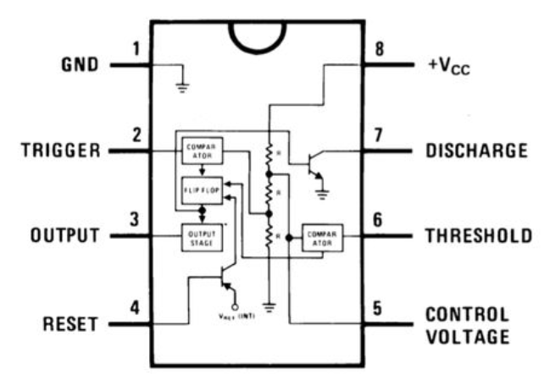
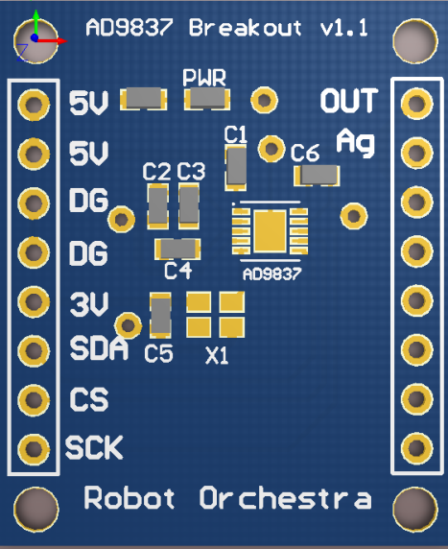
Arduino Timers (Francesco)
 | 555 Timer | Digital Signal Synthesizer
External components needed | 2xResistors 2xCapacitor | External oscillator, 2xCapacitors
Range | 0-500kHz | 0-1Mhz
Resolution |  | 0.02Hz
Current consumption | 5-10mA | 4mA
Notes:
Stepper Motors
After testing other methods we decided we needed a more accurate frequency generator, timers/interrupts won’t do + it limits how many steppers we can add.
Making it modular would improve the orchestra
Design1: use a 555 timers
Most produced/sold IC ever
Can produce frequencies up to 500khz when powered by 5v
Requires only a few passive external components 2 res 2 caps
External components set the freq.
Cheap, can drive the stepper driver easily
However…
Can’t get the resolution we need
Eg. G in the 6th octave is of a freq of 1567.98Hz, 555 would require: r1=38.337mΩ, r2=95.824Ω and C1 5.1μF. which are not realistic
So we would lose a lot of resolution, our frequency will be off, which is what we wanted to avoid in the first place by using a dedicated IC instead of timers/interrupts
DSS
More expensive ~£3.5 each
Requires an external clock
Can produce frequencies up to ~3Mhz, with a resolution of 0.02Hz – perfect for our needs
28-bit resolution, no external components everything is programmable using SPI.
It also means that we can reuse the steppers for other notes. ie one stepper can play multiple notes (since everything is programmable)
Can make the stepper instrument modular, add as many steppers as we need
Low consumption <4ma at the frequencies we need, can be pwrd from an aruino pin directly
Arduino has to only switch the IC on/off
Easy to design breakout, capable of driving a stepper driver directly
That’s the one we’re going with. Breakout completed and working properly, many libs available.

Slide 9
Progressing with Stepper Motors
Combine Stepper Driver + DSS + ATmega328 + ESP8266 on a single PCB
Mount Steppers on wooden base to enhance the sound
Write the software
Finalise, make improvements, add visual effects
Notes:
Steppers
Speaker box
Function generator + ICs, software (B3)

Slide 10
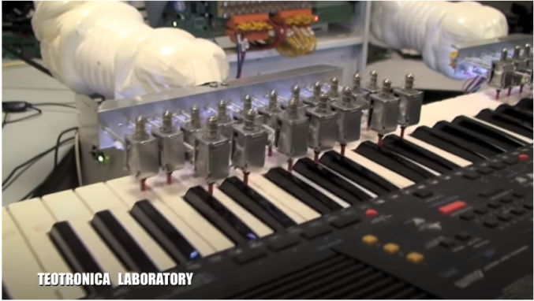
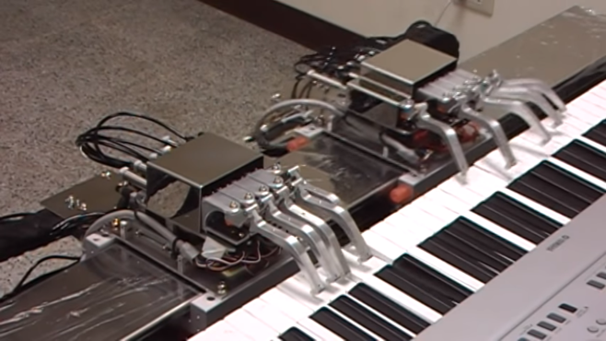
Keyboard image

Slide 11
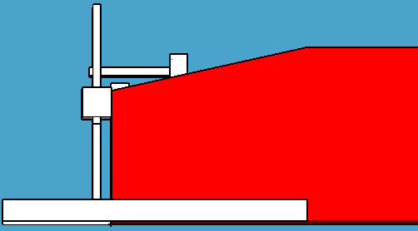
Keyboard (Joyanto and Theo)
19 notes
61 possible keys
Bosch bar
Supported by two threaded rods
Solenoids
5V DC solenoids - too weak to press keys
12V DC solenoids - more applicable
Several prototypes to produce final design
Notes:
After picking the songs it was found that only 19 keys were needed to play the songs which significantly reduces the number of solenoids that had to be brought (saving on budget) and how many had to be fixed to the bar
The bosch bar was selected as it allow the keyboard design to be more adaptable to several different keyboard designs
Tested two different types of solenoids to select the one to be used for the keyboard
Went through several designs and finally settled on this one for the keyboard

Slide 12
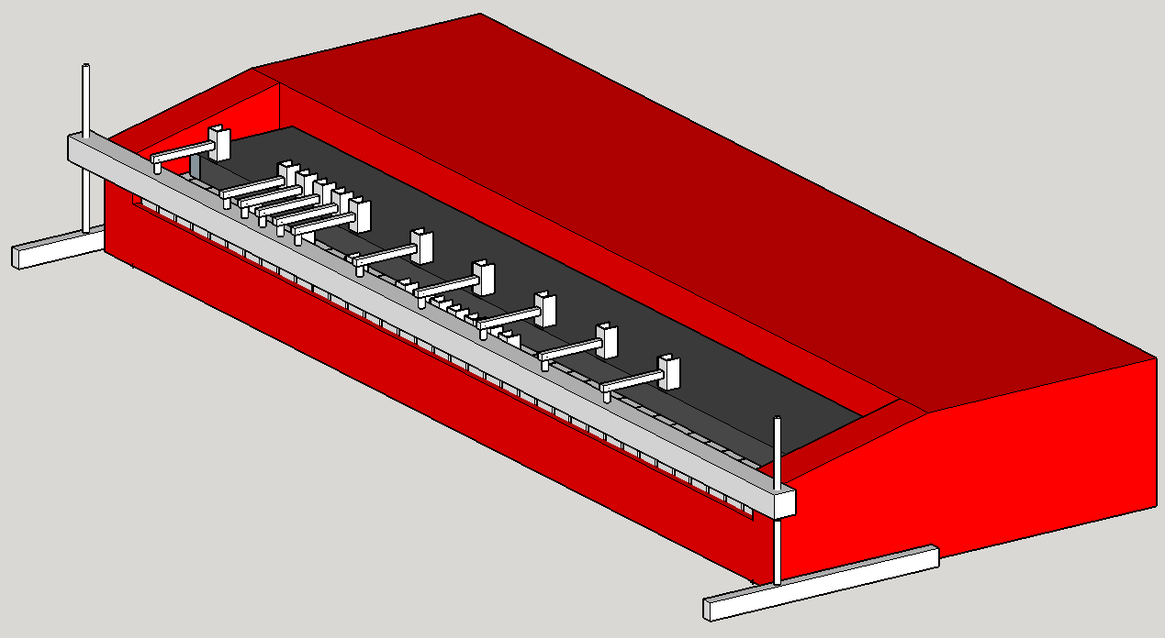
Keyboard

Slide 13
Progressing with the Keyboard
Software simulation
Hardware of keyboard still being constructed
Hardware
Cut bosch bar
Develop brackets for solenoids
Design and produce PCBs for solenoid circuit and Arduino
Integrate software with keyboard hardware
Notes:
Several steps to completing the keyboard design
Since the hardware is yet to be complete (due to several delays in delivering products) a simulation of the keyboard software will be created that has a mock output
It will output to the serial monitor of the IDE
This will be in development with the hardware and then be synchronised to work together

Slide 14
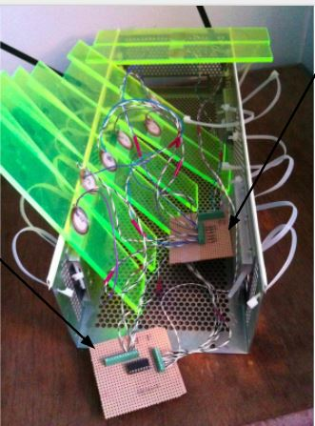
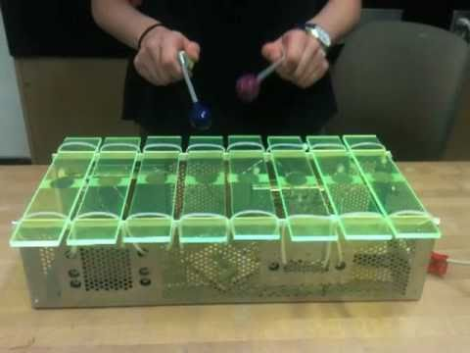
Xylophone background

Slide 15
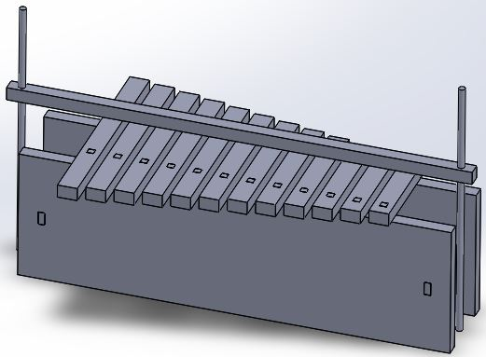
Xylophone (Theo + Josh)
12 keys – 8 natural notes and 4 flats
12 piezoelectric sensors
Used to produce signal to trigger a sound to be played
12 5V DC solenoids – one for each key
programmed to hit piezo sensors
Bosch bar
supported by two threaded rods
solenoids attached at the bottom side
Notes:
Xylophone
3D model
Piezo sensor Multisim (Maybe piezo demonstration)
12 keys -> 8 octaves and 4 flats
Bar for solenoids, Perspex, MyRio
Learning LabVIEW during tasks + NI scholarship technician
Use MyRIO because of simplicity after talking to Dan

Slide 16
Progressing with the Xylophone
Implement keyboard software and modify it
PCBs
Solenoids
Piezo Sensors
Bosch bar assembly
LabVIEW
Need to learn LabView
Mitigated by keyboard software
Notes:
Xylophone
Learn LabVIEW and implement software on it
PCBs (B4)
Solenoid bar (B3)

Slide 17
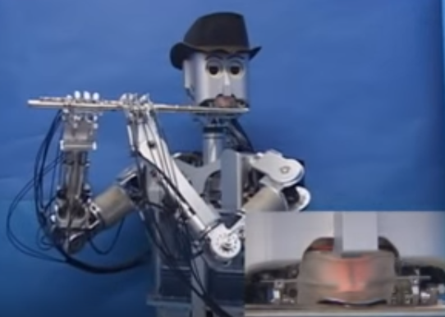
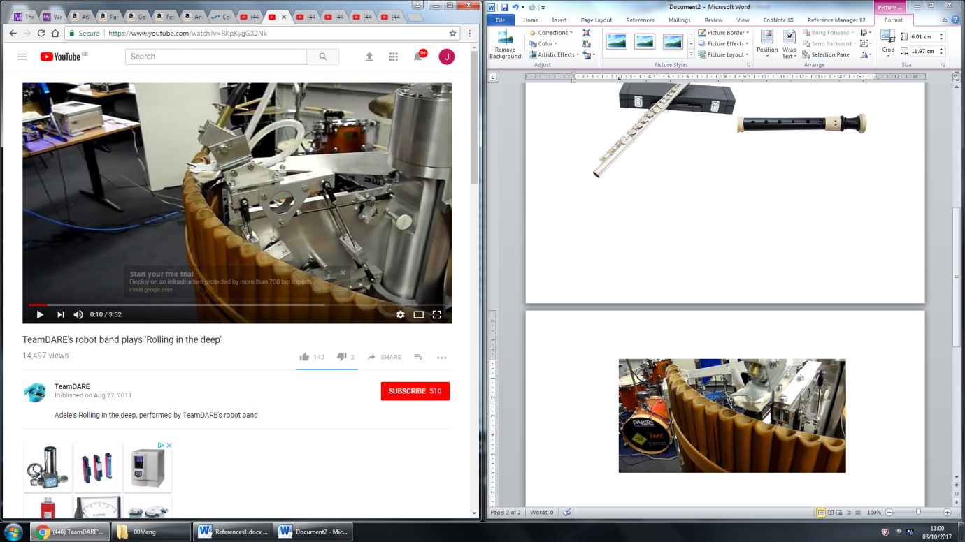
Panpipe background

Slide 18
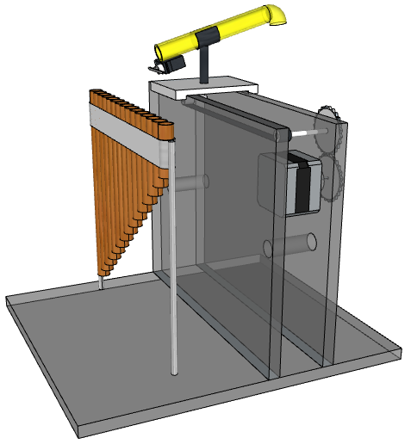
Panpipes (Josh + Anton)
15 pipes
Ranging from C5 to C7
Suitable for vocal notes
Air pump provides airflow
Air needs to be blown across each pipe
Noise made by pump
Decision between Tesla coil and panpipes
Original design
Only 1 nozzle
The nozzle moves to each pipe
Notes:
Panpipes
3D design for the new model
Panpipe note range
Testing phase (delayed)
Initial findings: pressure, noise Risk because of noise

Slide 19
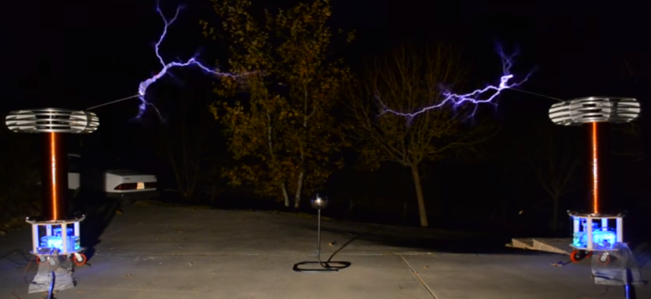
Tesla Coil Background
Notes:
Tesla
Backup
Meeting with Vidi
Testing and safety
Independent research
Demonstration (video) insert
When we initially saw tesla coil videos would be a cool addition to the orchestra
Initially we got some tesla kits to test which worked very effectively but are quiet (video)
To make it louder it needs to use a larger voltage to produce larger streamers
Met with Vidi in the high voltage lab -we can use lab for testing and there tesla coil and there are coils available
Safety due to the low power the coils should be safe but use a cage to catch the streamers
The next stage is the circuit design and understanding the control needed to modulate the switching with the music signal.
Specifying the components.
Building and testing

Slide 20
Tesla Coil
Tested DIY tesla coil kits
Researched switching circuits to power tesla coils
Talked about testing the design in the HV lab

Slide 21
Progressing with the Panpipes & Tesla
Criteria for proceeding with the Tesla coil:
Research how to interface the music information with the switching circuit
Testing could be limited by HV Lab availability
Criteria for proceeding with the Panpipes:
Further testing to making sure each note can be clearly produced
Coming up with an effective solution to limit the noise from the pump
Deadline 7th February
Notes:
Panpipes and Tesla coils
Panpipes: Made a decision based on air pump test, new compressor (B3)
Panpipes: Mention noise, possible notes produced and cost
Tesla coil: Seen that it works
Tesla coil: Simple circuit
Tesla coil: Power aspect and visuals
Test to see if current circuit design can be used with a larger tesla coil
Understand how current circuit works
Research how to control the switching circuit to produce music with a microcontroller.
Availability of testing time in the HV Lab

Slide 22
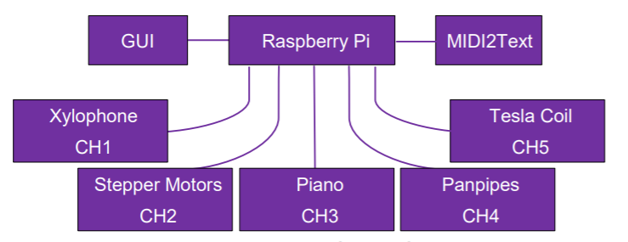
Conductor (Francesco)
Will handle most of the ‘heavy’ processing
Decode MIDI files into a format uC’s can understand
Send corresponding data to individual instruments
Synchronise Instruments to start simultaneously.
Method | Module Price(£) | Documentation | Protocols | Integration with existing hardware
WIFI | 5 | Largely available | Largely available | Works well with all hardware
Bluetooth | 3 | Largely available | Not very available | Works well with all hardware
Radio | 4 | Largely available | Not very available | Difficulties integrating
Notes:
Conductor design
Conductor will be a Rasberry Pi
Why?
Cheap, has built in WIFI
Can be programmed in many languages inc. Python
Can attach screen, basically a pc, speed up protoyping
Takes 1 input: a MIDI file
Passes it to the MIDI2Text file which:
Extracts the info needed for the instruments (timing,notes,action) and stores them in a format which is easy for a uC to understand. i.e 3 arrays
Array1: time in seconds (converted from time in ticks) the instrument needs to wait prior to executing the command
Array2: note, which note the action will be performed upon
Array3: Action, what action should be performed on the note. Such as note ON and note OFF
Array4: Velocity, how hard or soft a note is hit. Currently info is being extracted but not saved, we might need it for the piano
Once the data has been parsed and stored in the arrays it is then transmitted to the corresponding instrument.
Note: Channels for each instrument are static and are predefined. They should be edited in Anvil Studio prior to passing the midi file to midi2text
Show the diagram of the conductor with the instruments
Finally, the conductor will have a GUI installed in it to allow control over the orchestra in a simple manner, without having to alter the code manually or anything like that. The GUI will be simple.

Slide 23
Conductor (Francesco)
Protocol Decision
Message Queing Telemetry Transport MQTT
Enables publish/subscribe messaging model
Extremely lightweight/Small code footprint
Extensive Python + Arduino documentation

Slide 24
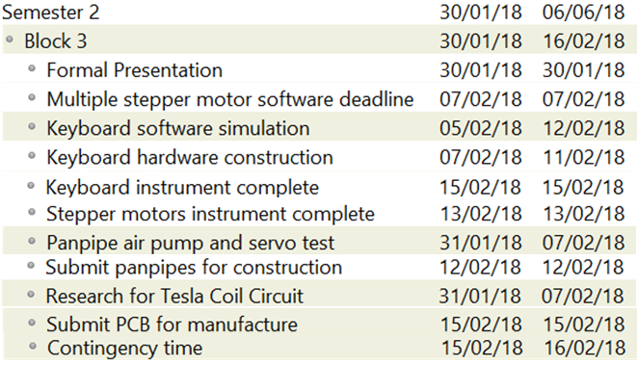
GANTT Chart – Block 3 (Joyanto)
Notes:
Block 4 will be focused on either finishing the tesla coil or the panpipes and building on the work done on project block 3
Some time will also be spent integrating the software for the xylophone and hardware of the xylophone together
By the end of this block all 4 of the instruments should be constructed and integrated

Slide 25
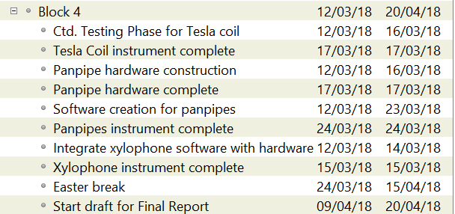
GANTT Chart – Block 4 (Joyanto)
Notes:
Block 4 will be focused on either finishing the tesla coil or the panpipes and building on the work done on project block 3
Some time will also be spent integrating the software for the xylophone and hardware of the xylophone together
By the end of this block all 4 of the instruments should be constructed and integrated

Slide 26
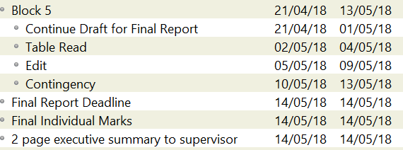
GANTT Chart – Block 5 (Joyanto)
Notes:
Final block is focused on the final report
Given the size of the report we thought it would be smart to give it plenty of time construct a draft and edit
The approach involves building upon the draft that was started in the previous project block
Finishes partway through the second week of the block
This point a table read begins where we go through each section as a group to make sure that the report flows
Once the table read is complete members will go away and edit their individual sections which is then stitched back together
There’s 3 days of contingency at the end in case the editing takes longer than expected

Slide 27
Summary
Stepper motors and keyboard
Stepper motors – single motor working with music
Keyboard – hardware designed, waiting on part delivery
Completed by the end of Project Block 3
Xylophone and Panpipes/Tesla
Xylophone hardware – has been laser cut
Initial Research between Panpipes and Tesla coil
Completed by the end of Project Block 4
Final project block is dedicated to the Final Report and preparing for presentation

Slide 28
Thank you for listening

